Slide 1
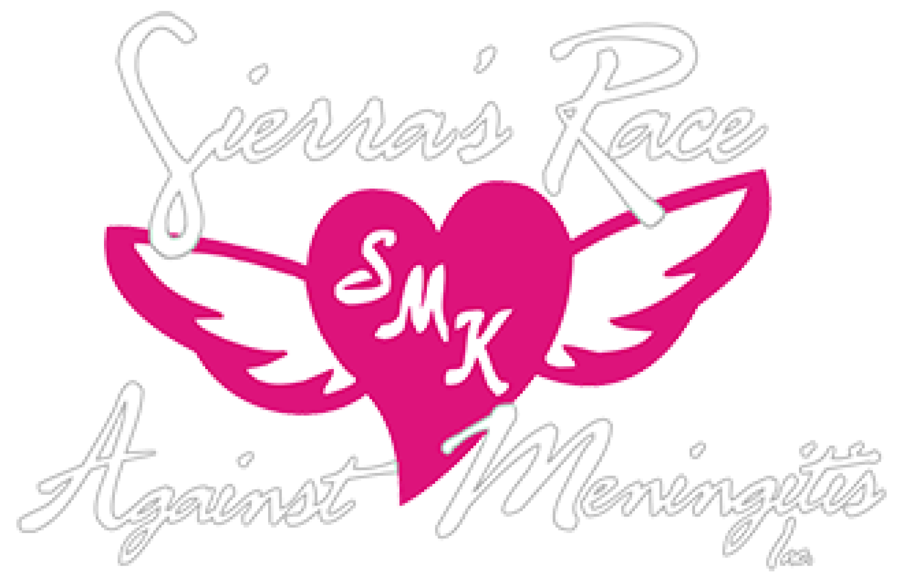




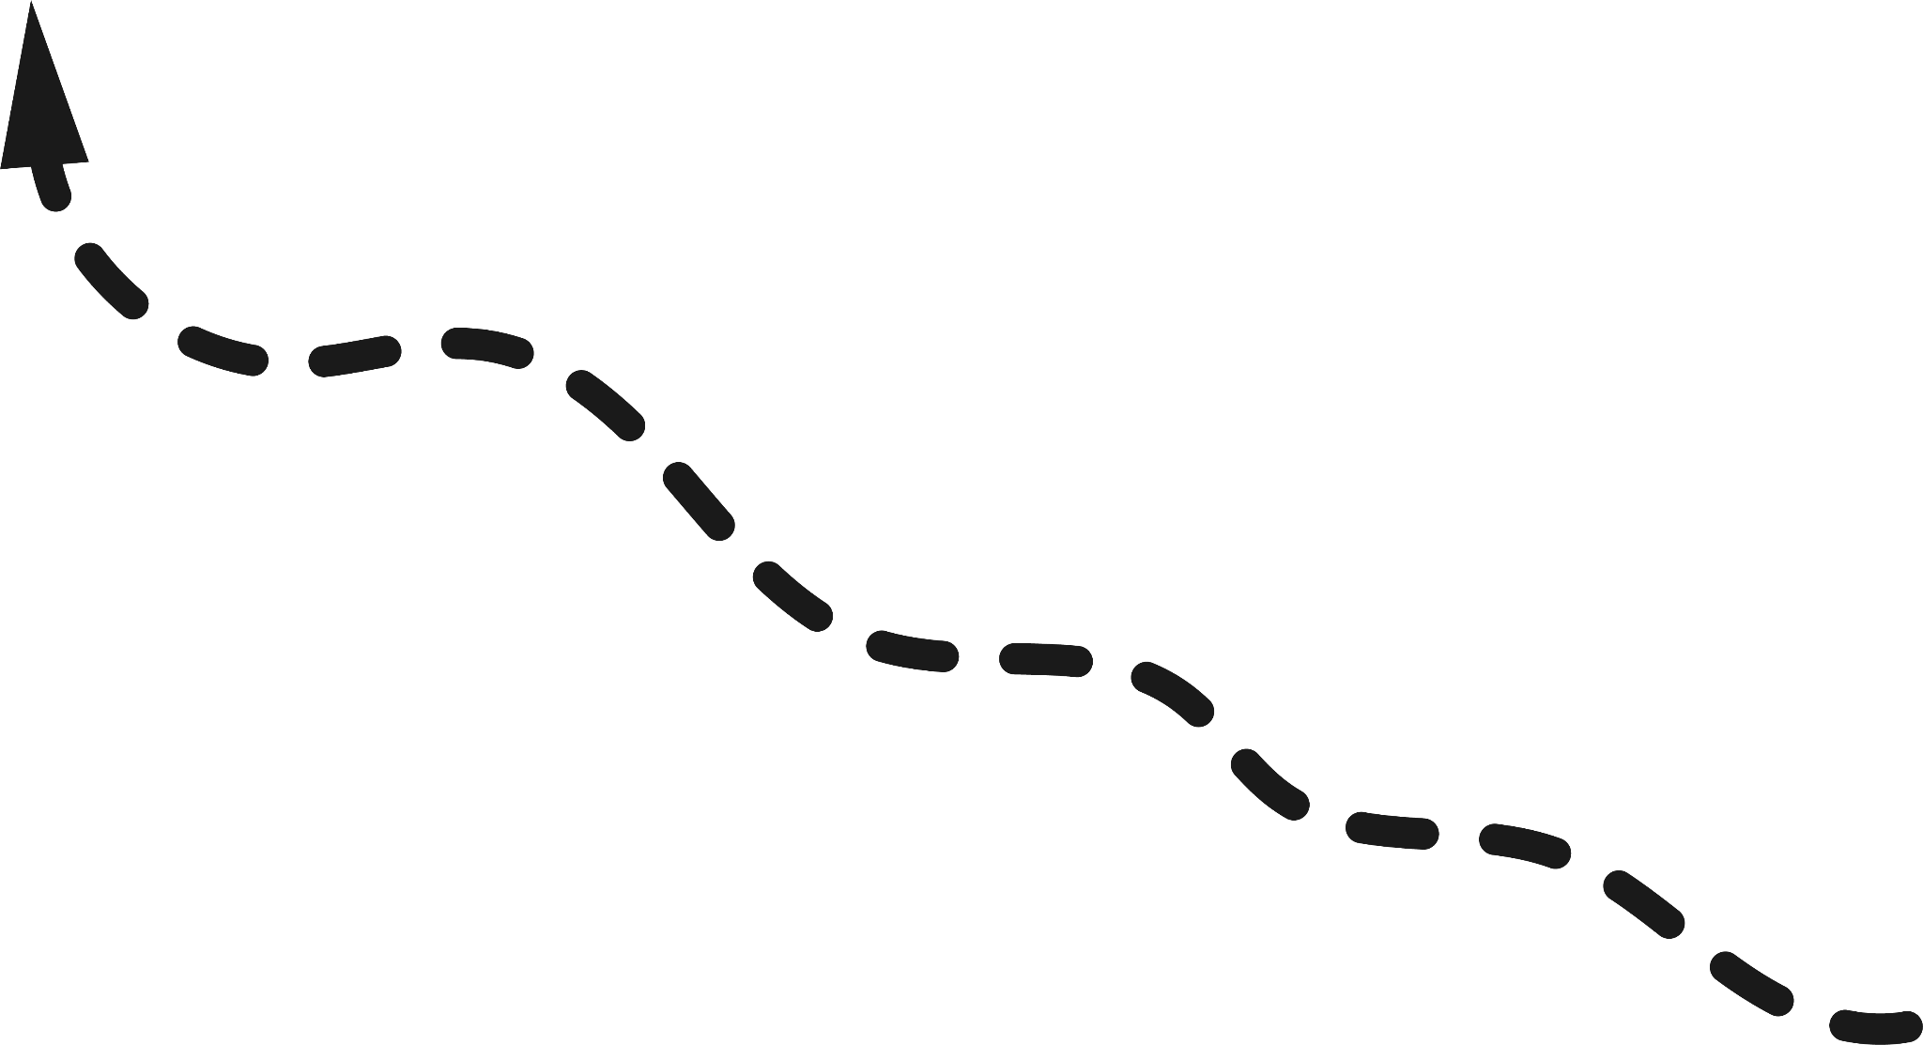
NON-PROFIT REDESIGN PROJECT
Kira, Kevin, Garrett, & Roxanne
July 11th 2024

Slide 2
RESEARCH & IDEATION

Slide 3
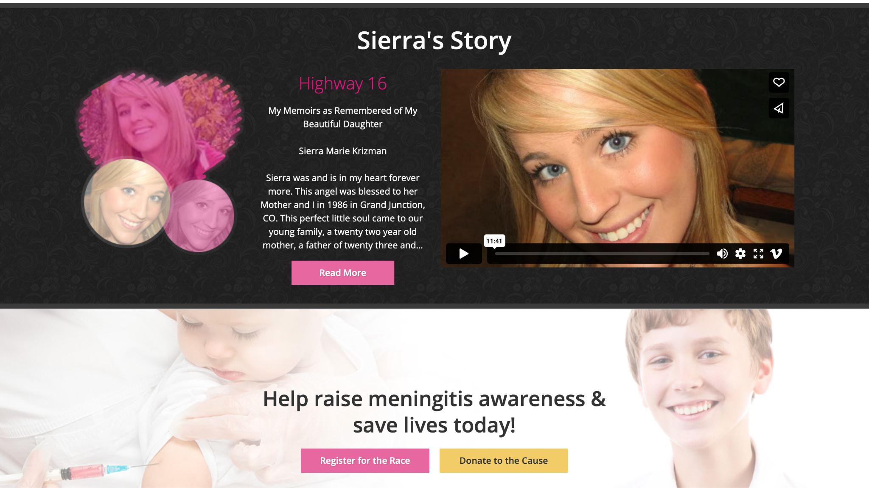
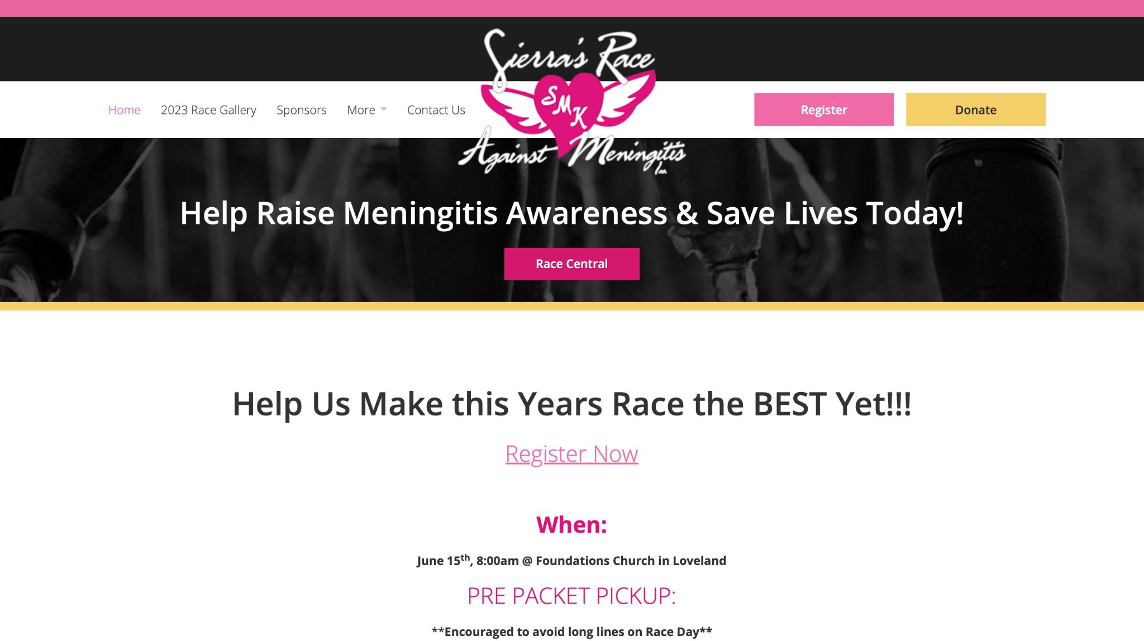
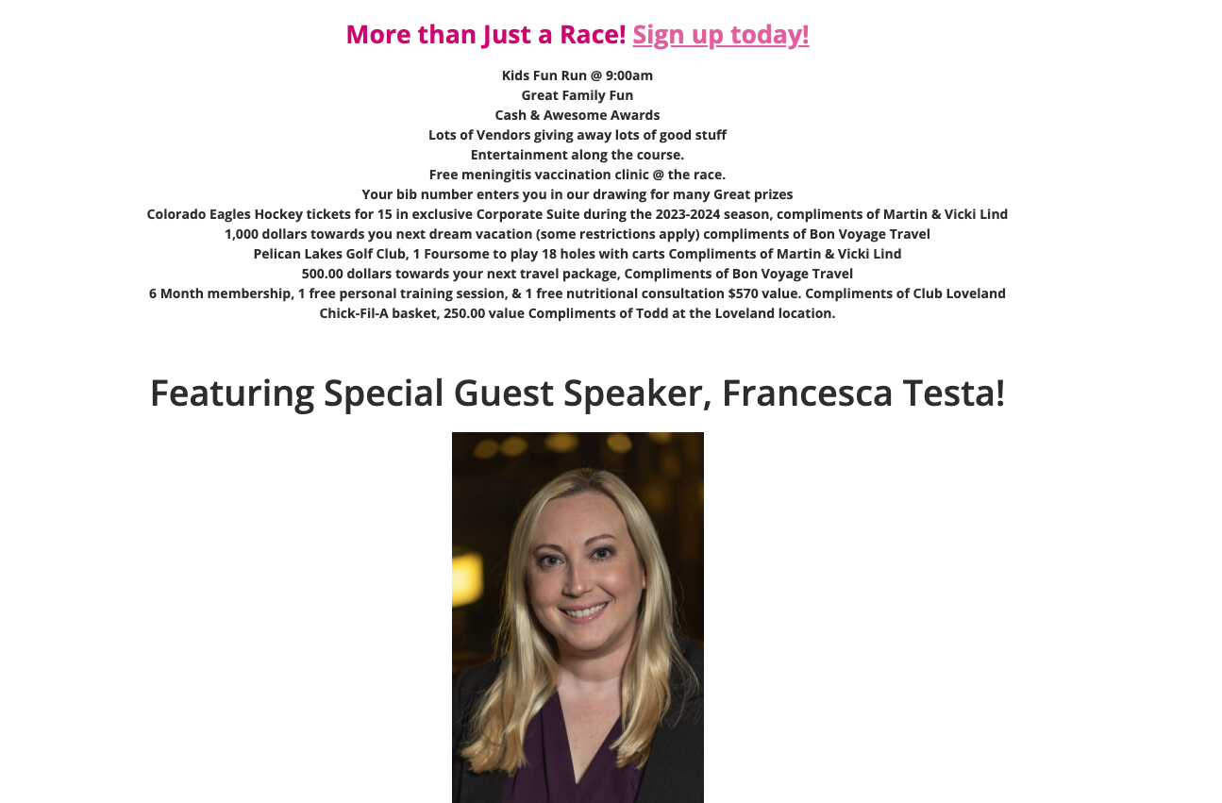
Key Issues
Lack of Visual Hierarchy
Scattered Information
Aesthetic and Navigation Problems

Slide 4
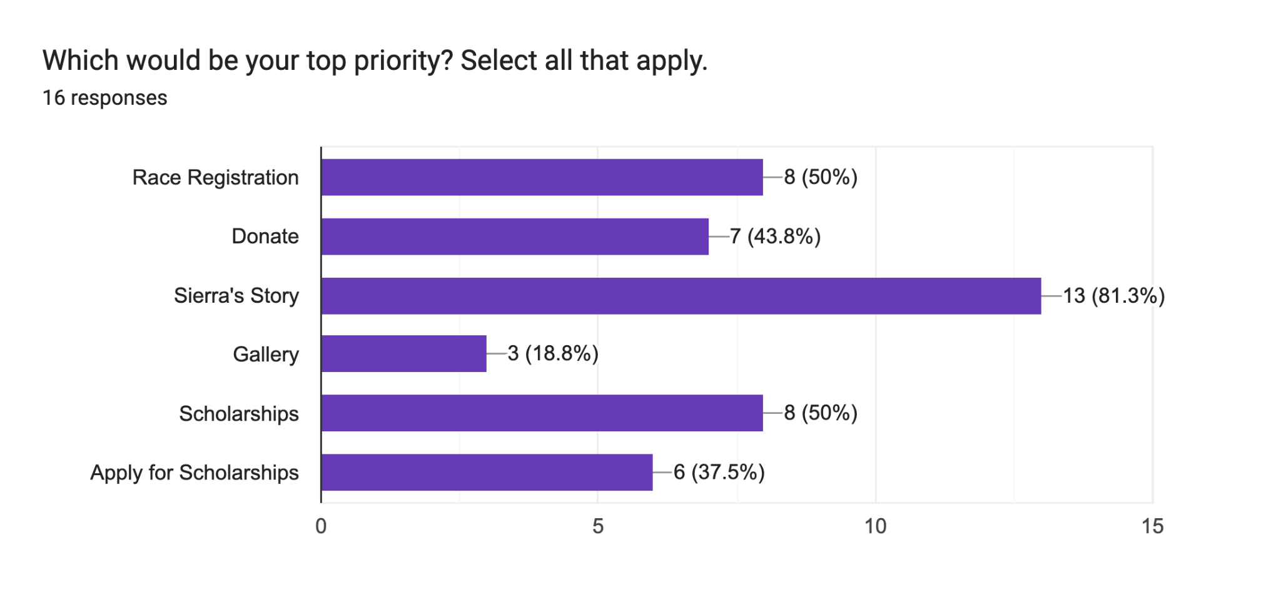
We noticed that navigating to Sierra's story on the original website was not straightforward. Therefore, in the redesign, we made sure that users can easily find and access her story

Slide 5
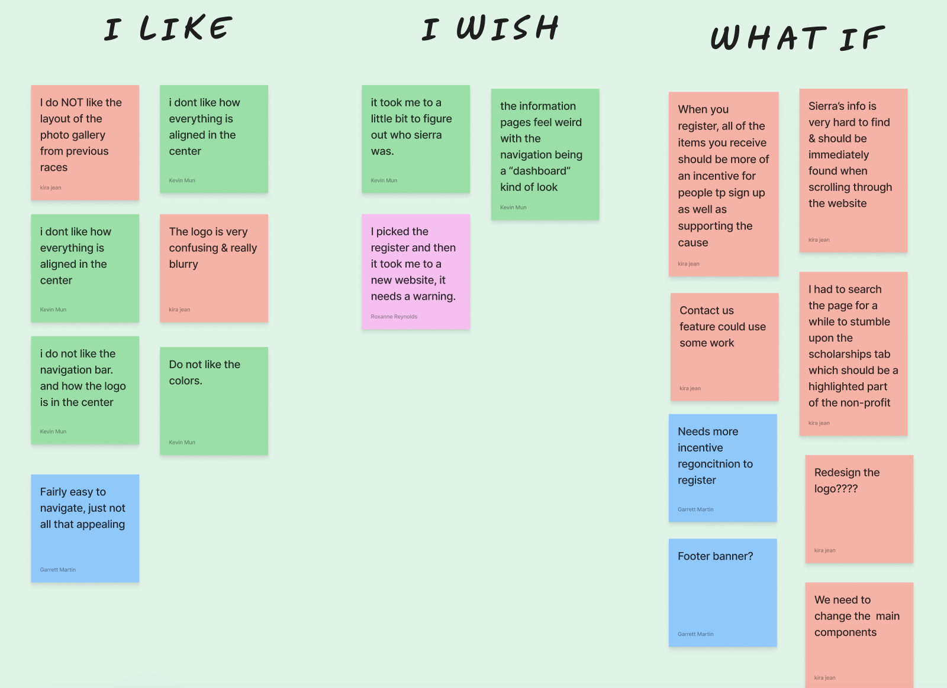
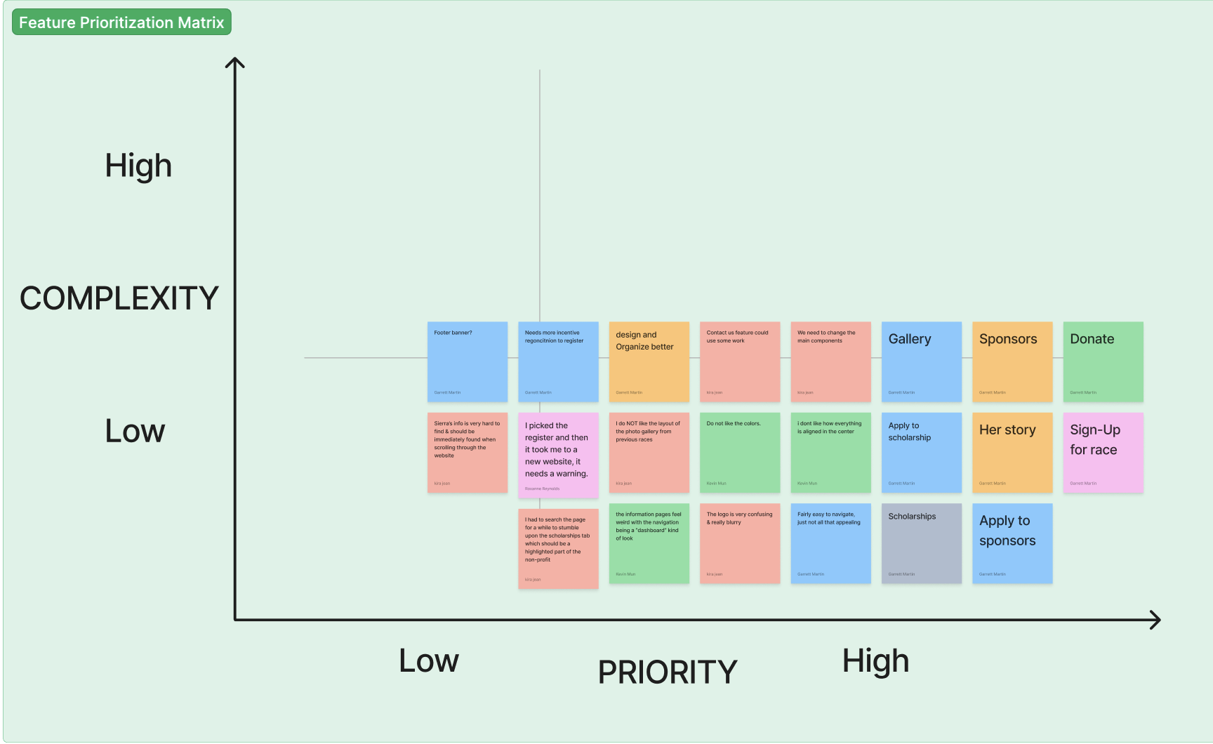
Based on our affinity diagram from user interviews, we organized the main points into an 'I Like, I Wish, What If' matrix to better understand our focus areas for the redesign process. Fortunately, there weren't many positive comments about the current website, giving us significant opportunities for improvement.

Slide 6
IDEATION & BRAINSTORMING

Slide 7
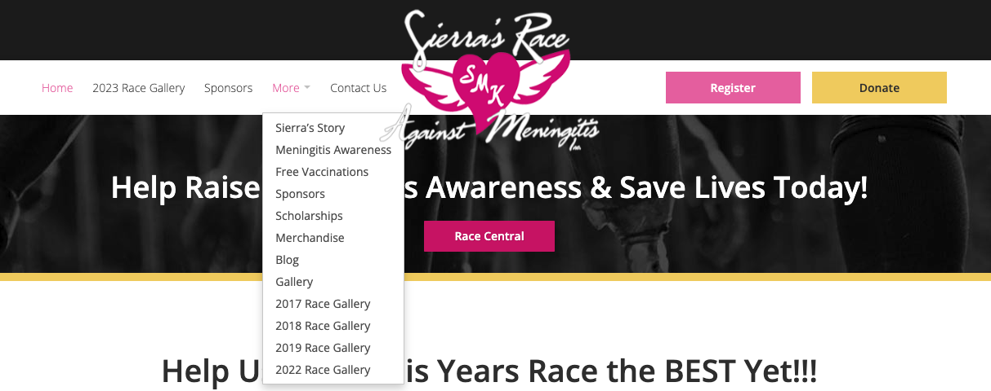
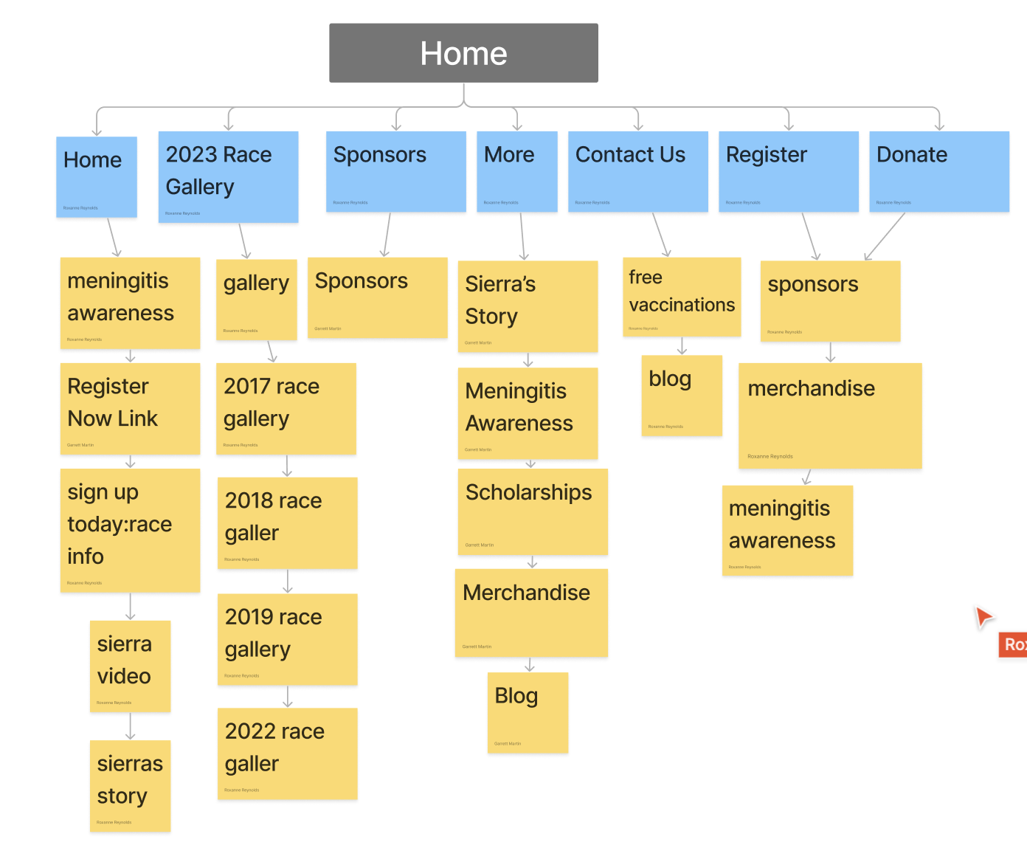
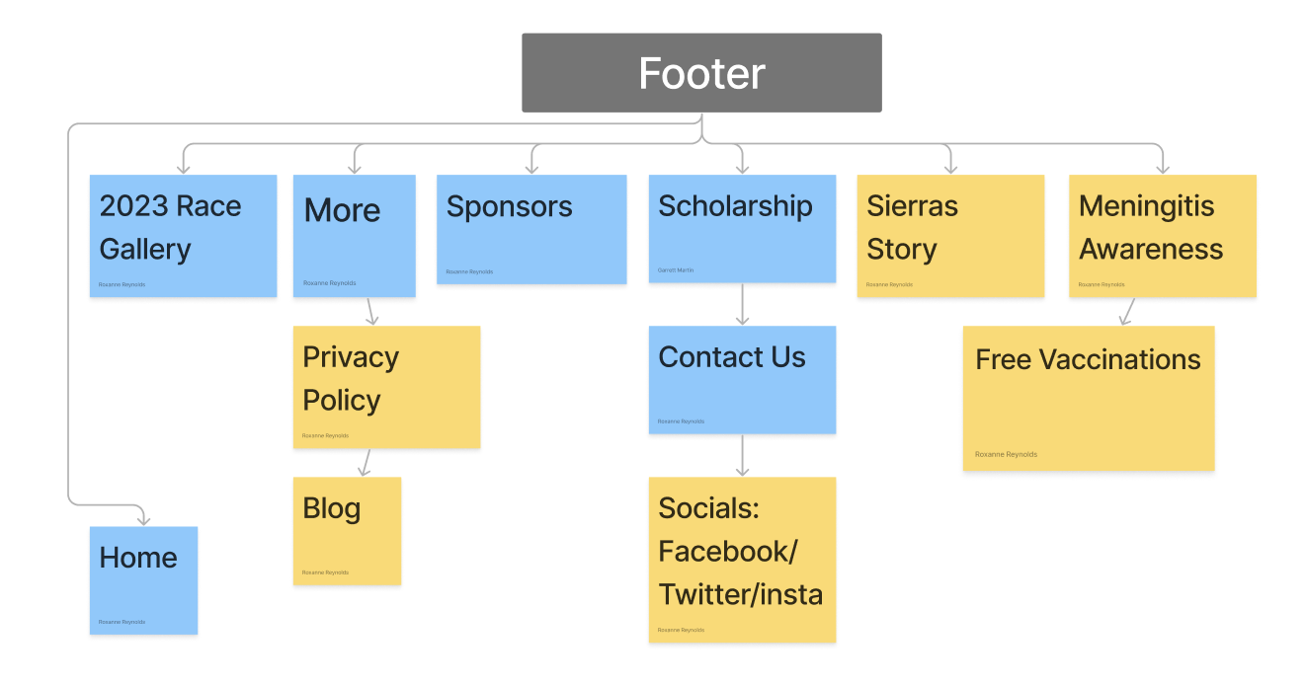
OLD SITEMAP
Based on our user interviews and their feedback on the website, we created cards highlighting key points. After creating all the cards, we categorized them based on similarities. These similarities were then transformed into a navigational map, guiding us in designing the most optimal sitemap.

Slide 8
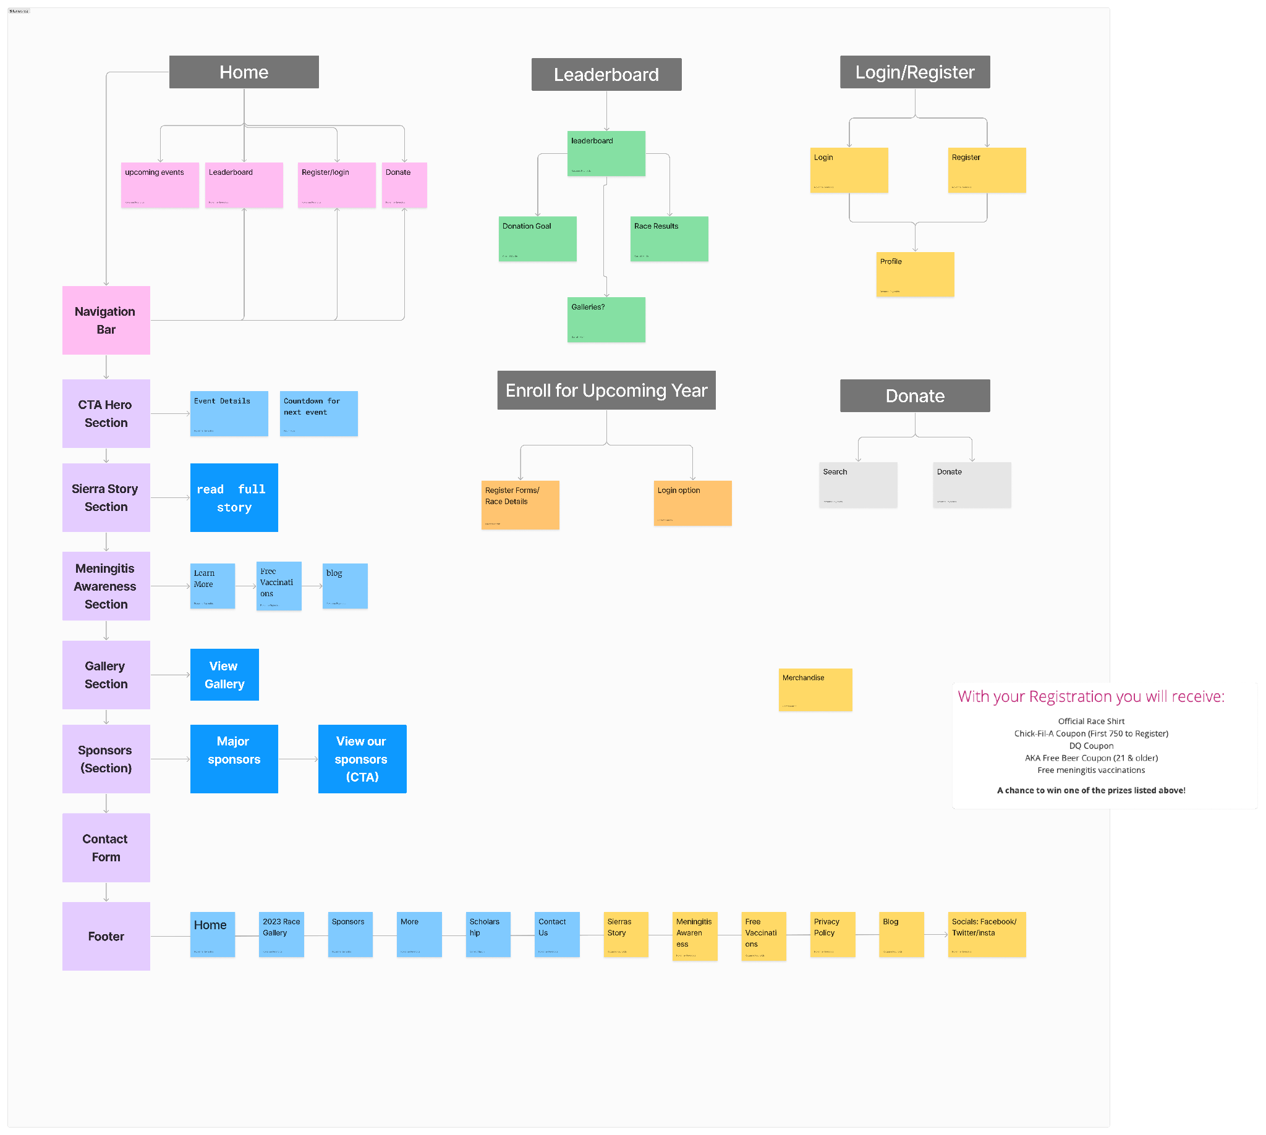
NEW SITEMAP

Slide 9
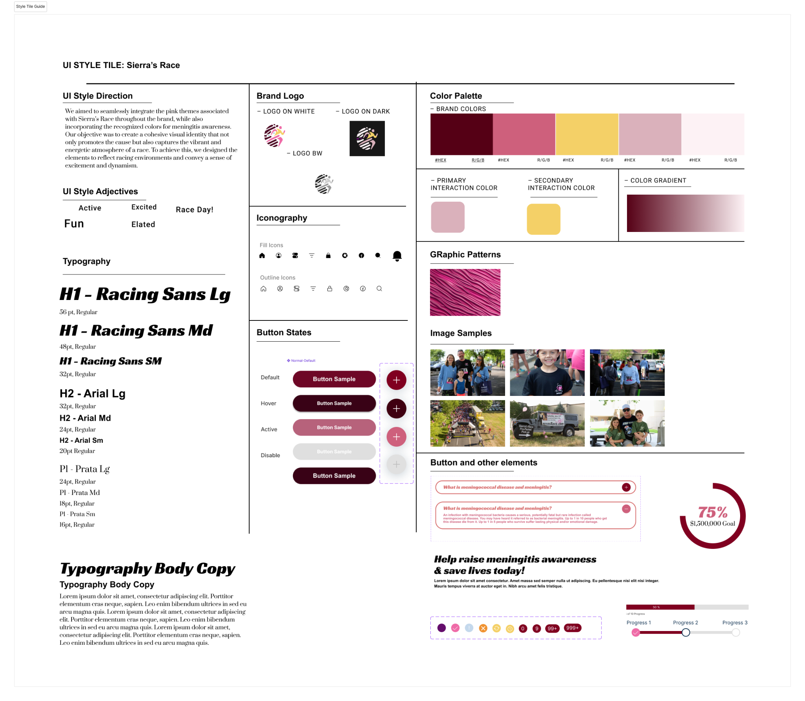
UI Style Guide

Slide 10
PROTOTYPING
Desktop Prototype
Mobile Prototype

Slide 11
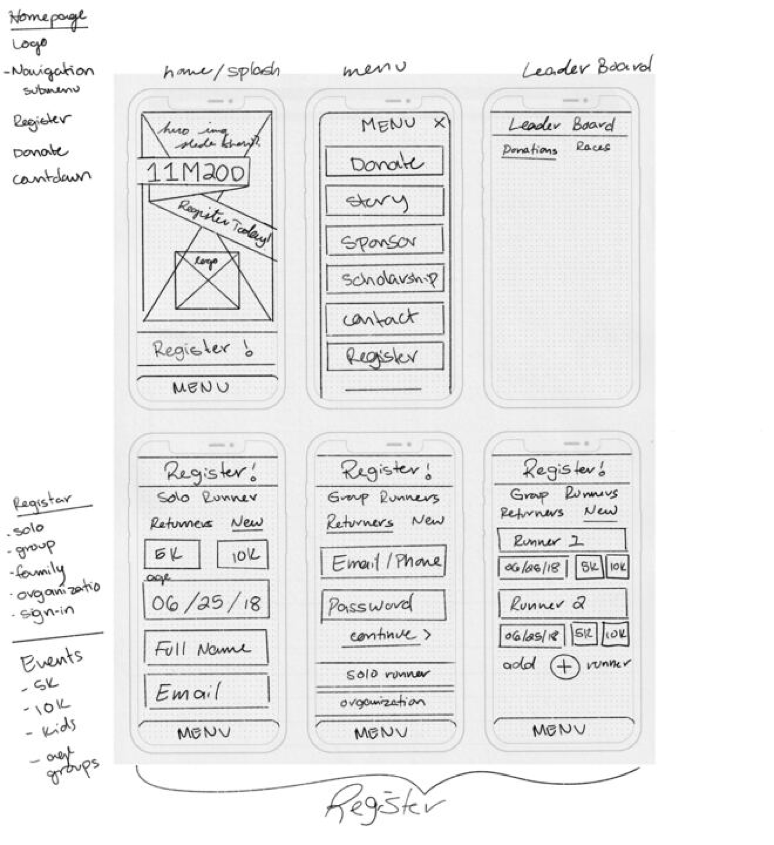
PAPER PROTOTYPES
We brainstormed ideas for the new website design and sketched a detailed paper prototype wireframe flow. Our primary objective is to provide users with a more comprehensive and engaging experience.

Slide 12
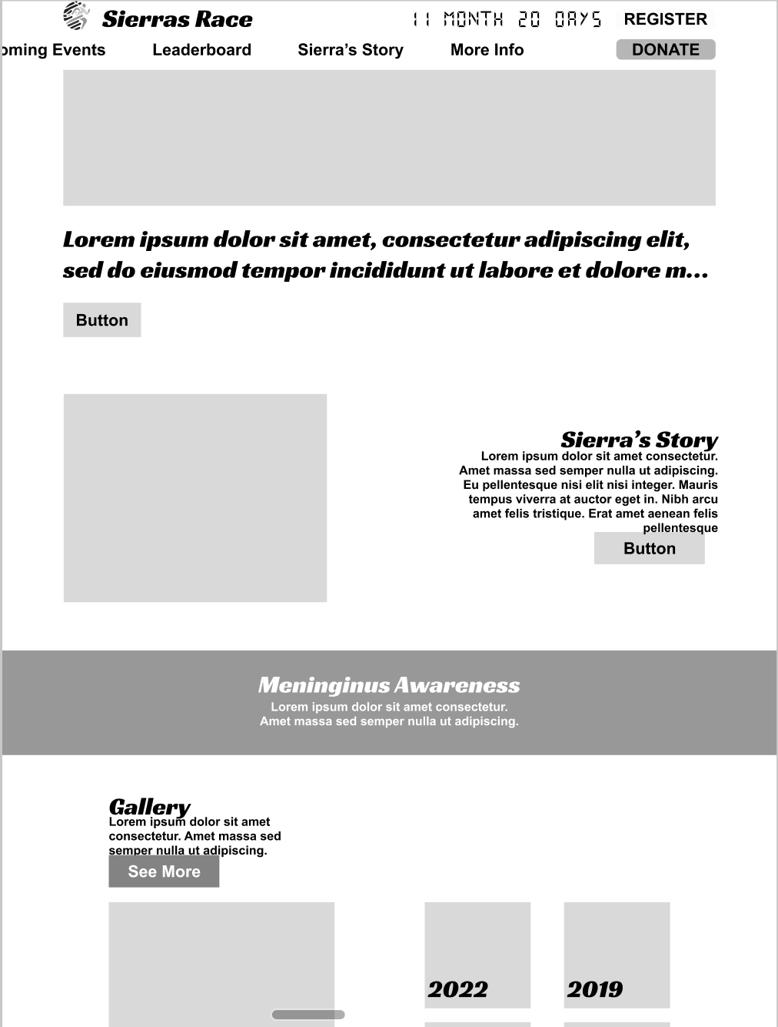
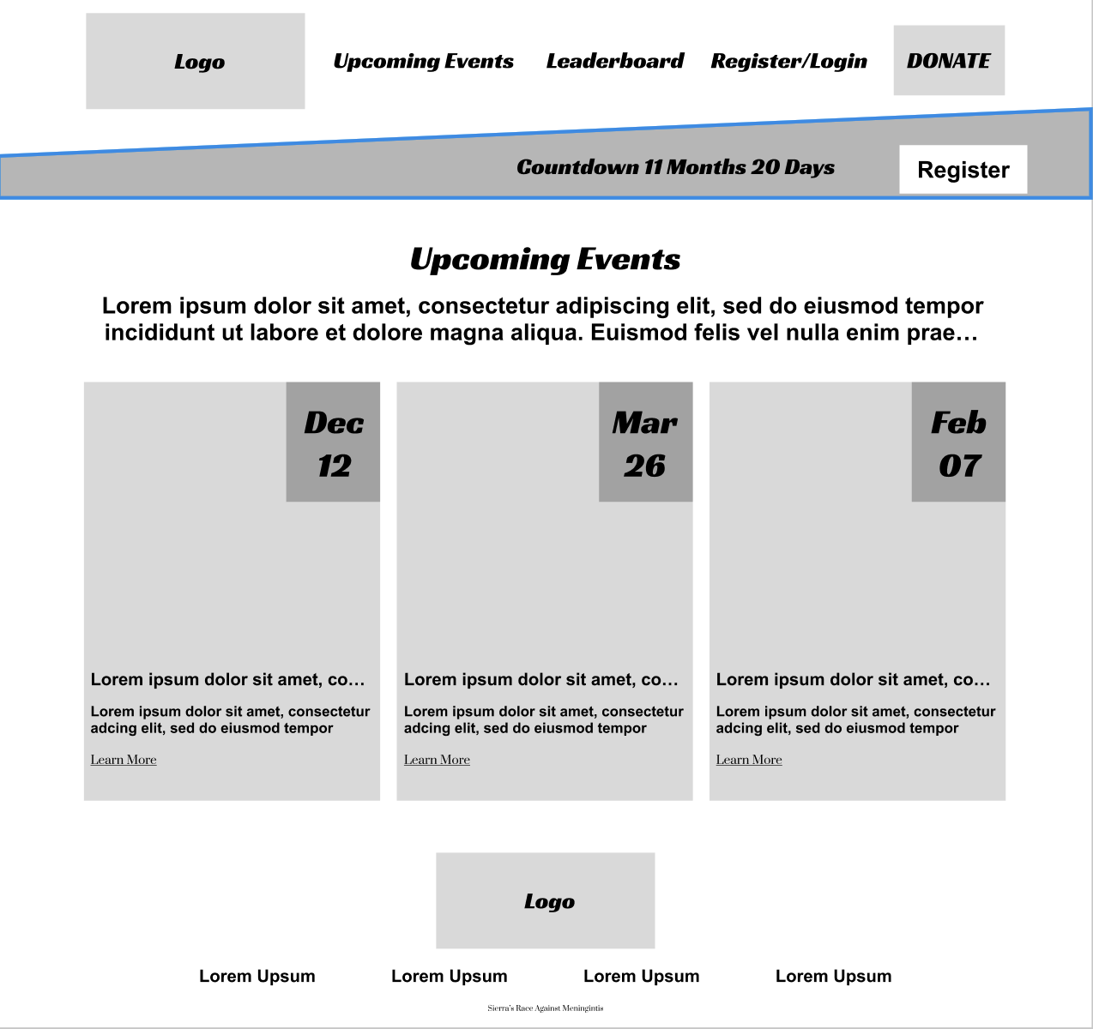
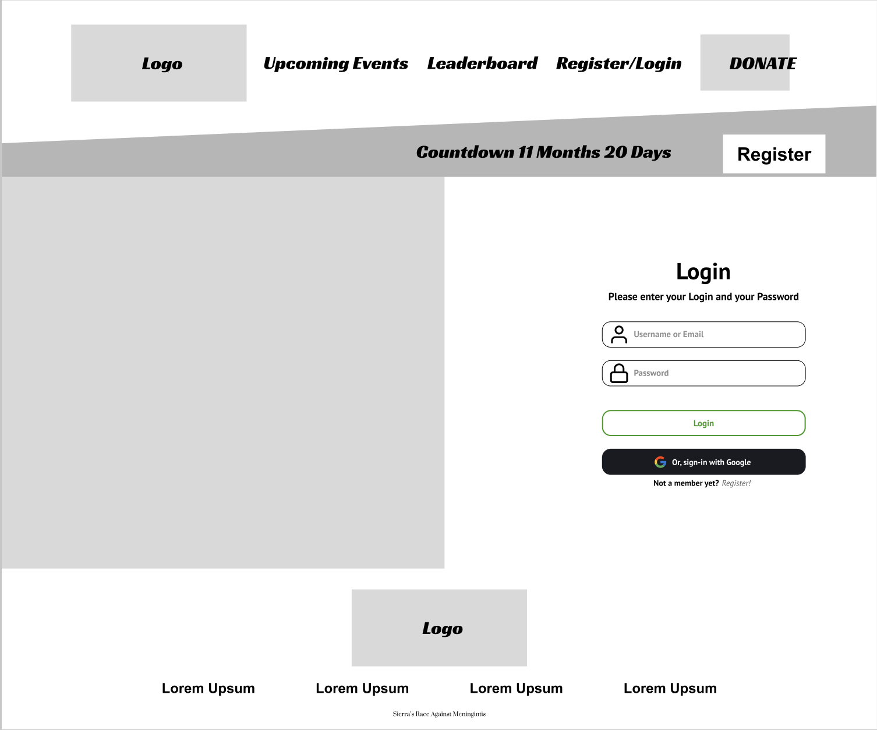
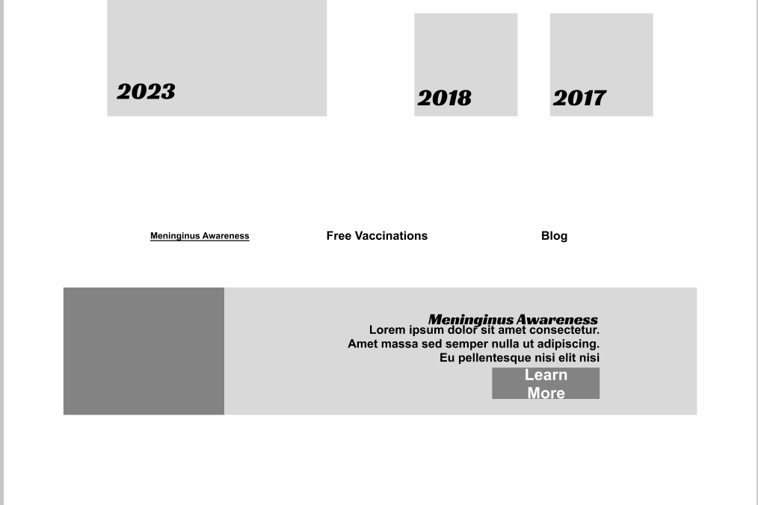
LO-FI PROTOTYPE
With our comprehensive sitemap, innovative ideas, and detailed paper prototypes, we've developed an enhanced low-fidelity prototype for the "Sierra's Race Website." The homepage prominently features Sierra's story, complemented by an engaging gallery and a convenient countdown to the next race located just below the footer.

Slide 13
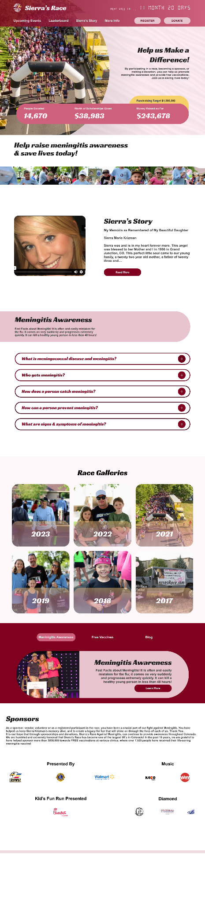
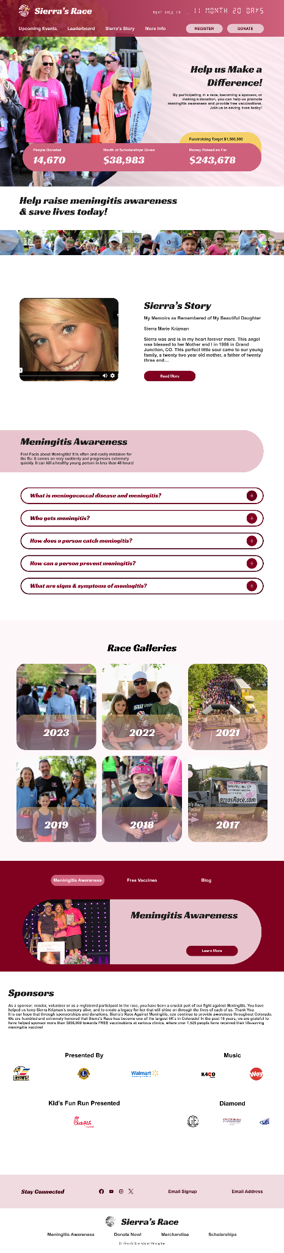
HI-FI PROTOTYPES
- DESKTOP 1/2
HOMEPAGE

Slide 14
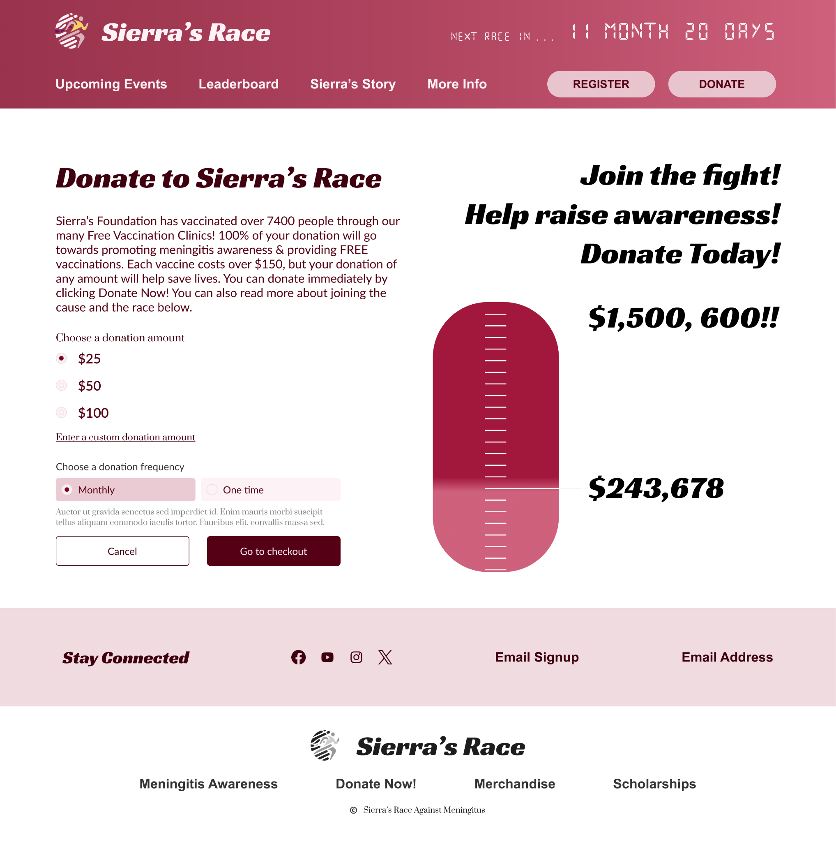
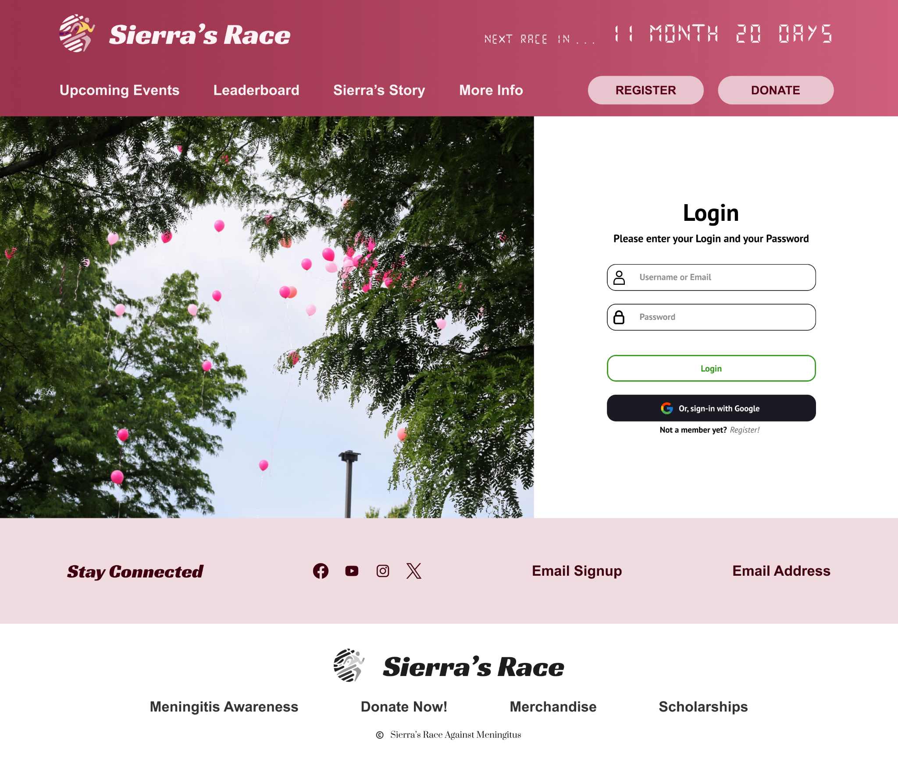
HI-FI PROTOTYPES - DESKTOP 2/3

Slide 15
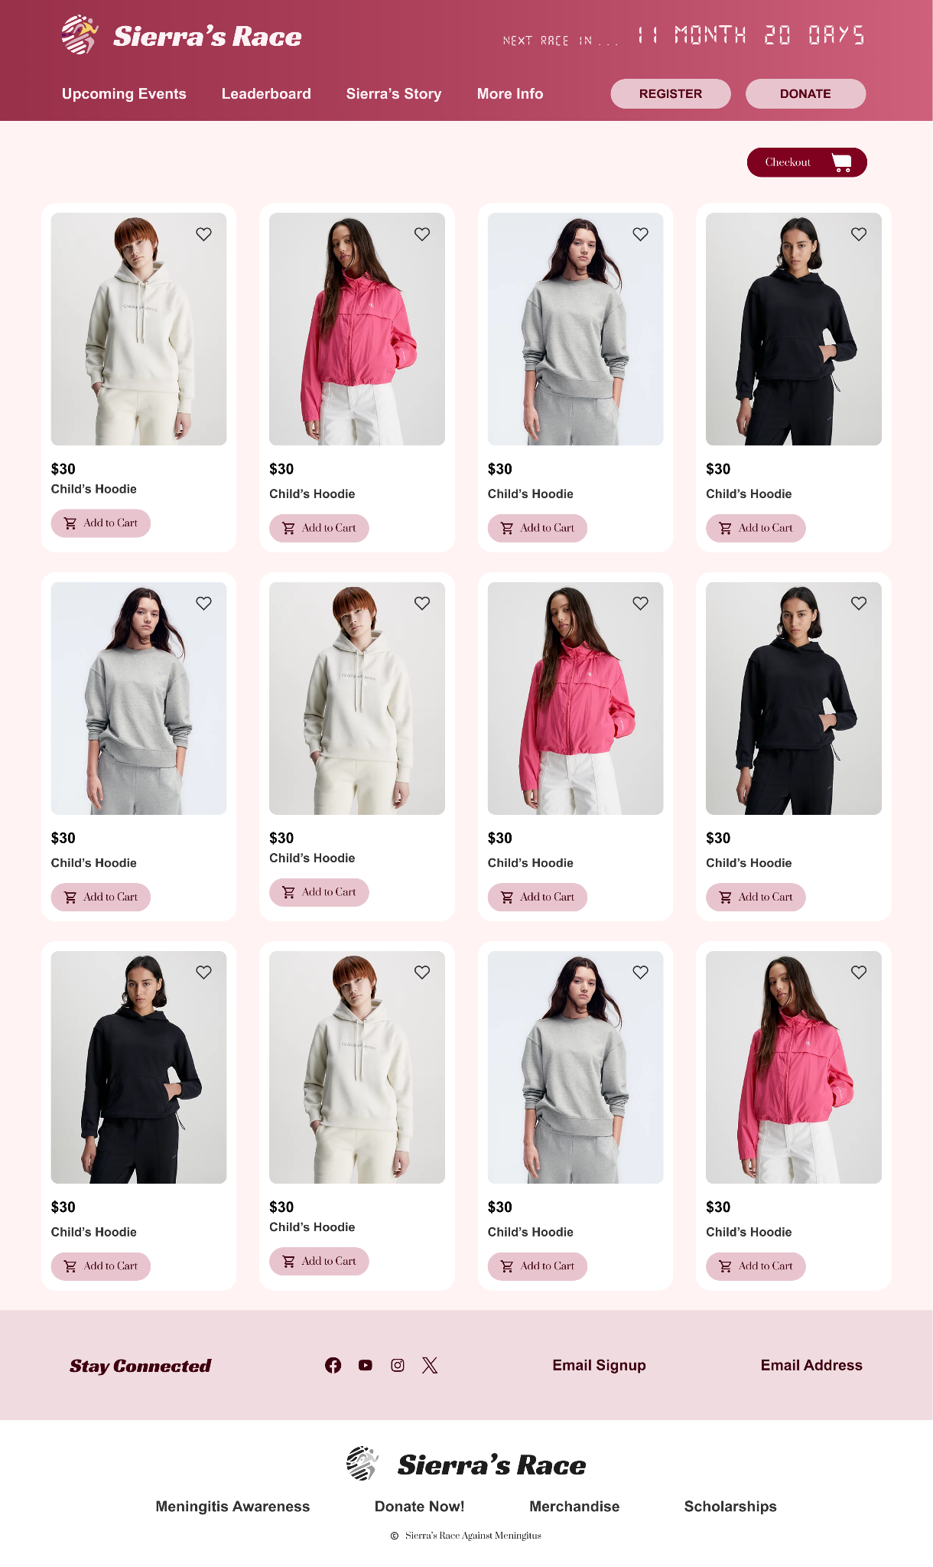
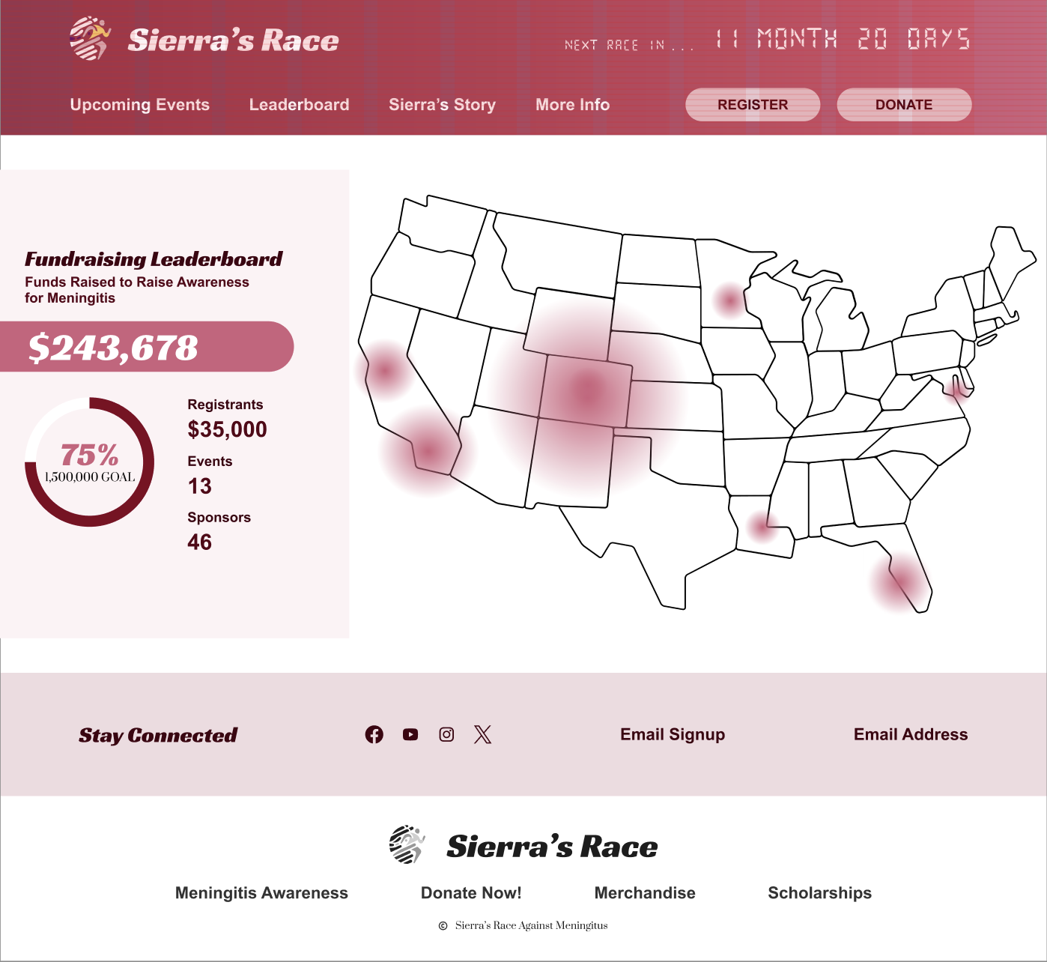
HI-FI PROTOTYPES - DESKTOP 3/3

Slide 16
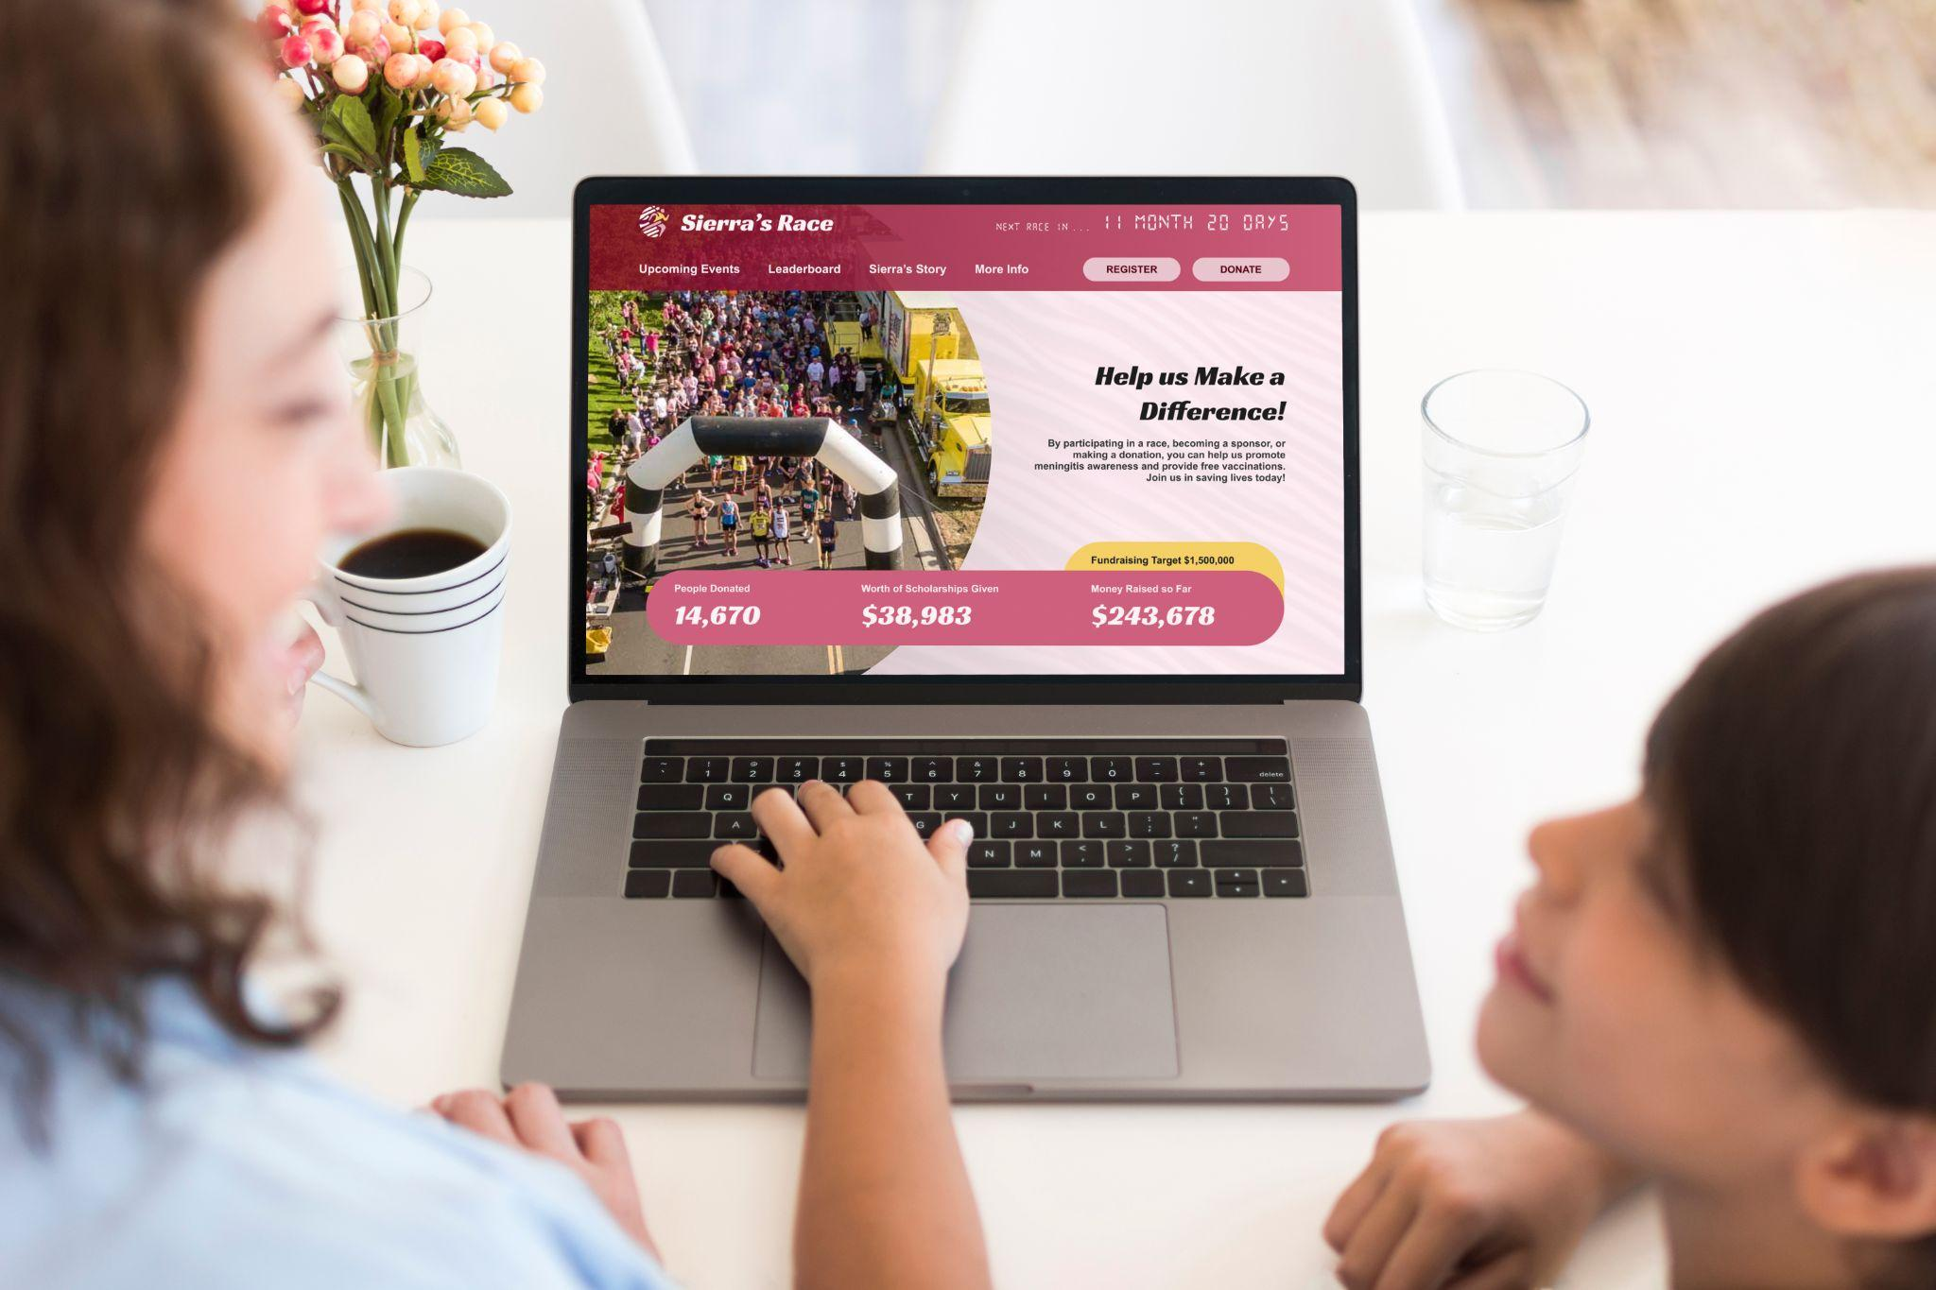

Slide 17
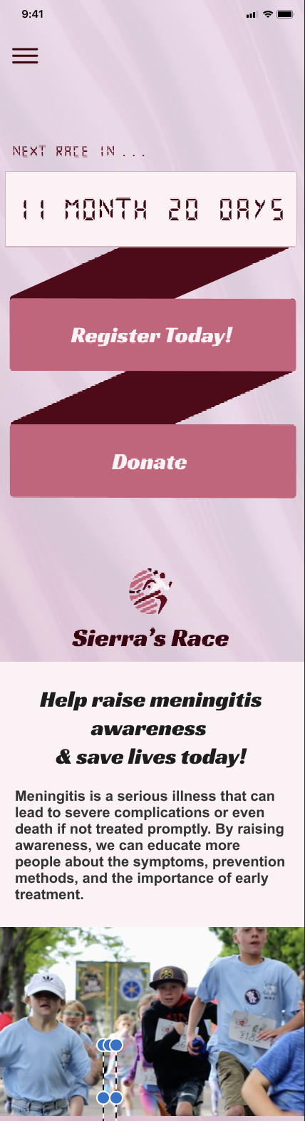
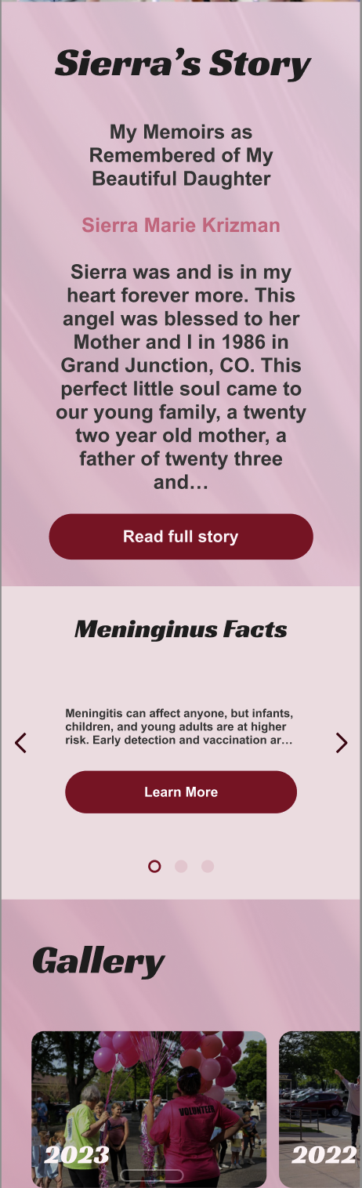
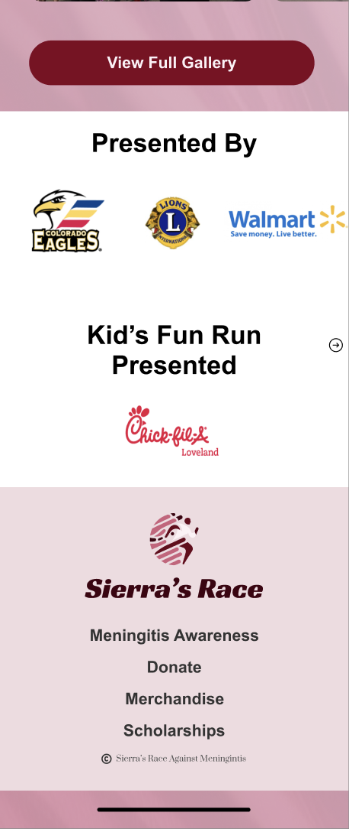
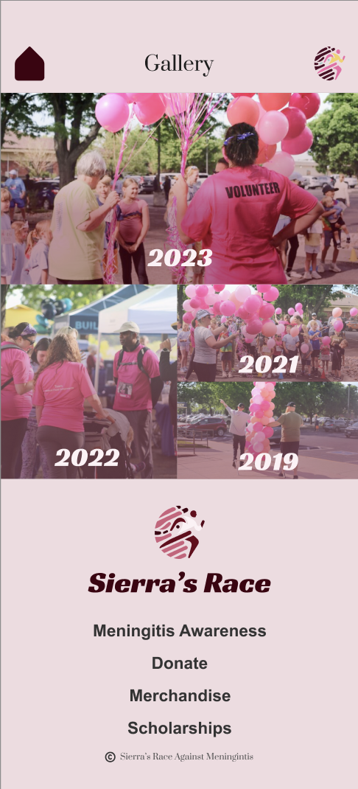
HI-FI PROTOTYPES - MOBILE 1/5
Home Page
Gallery

Slide 18
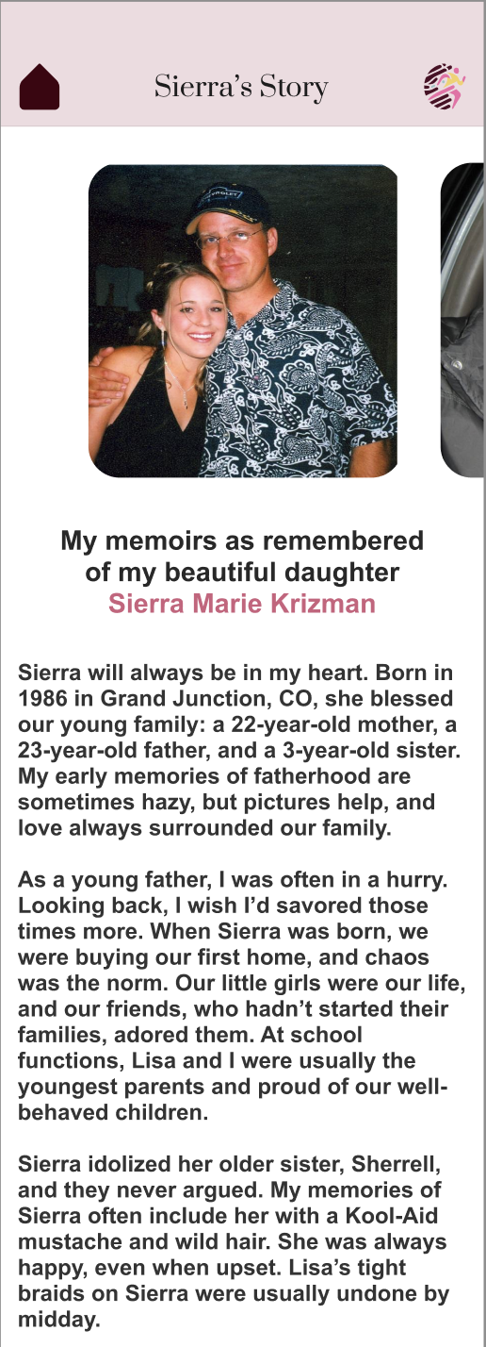
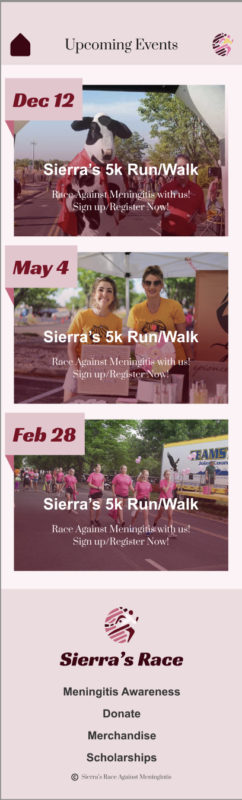
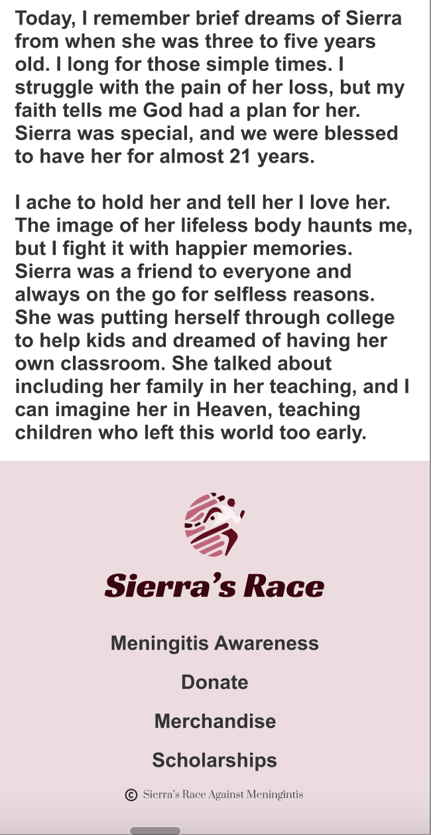
HI-FI PROTOTYPES - MOBILE 2/5
Sierra’s Story Page
Upcoming
Events
Page

Slide 19
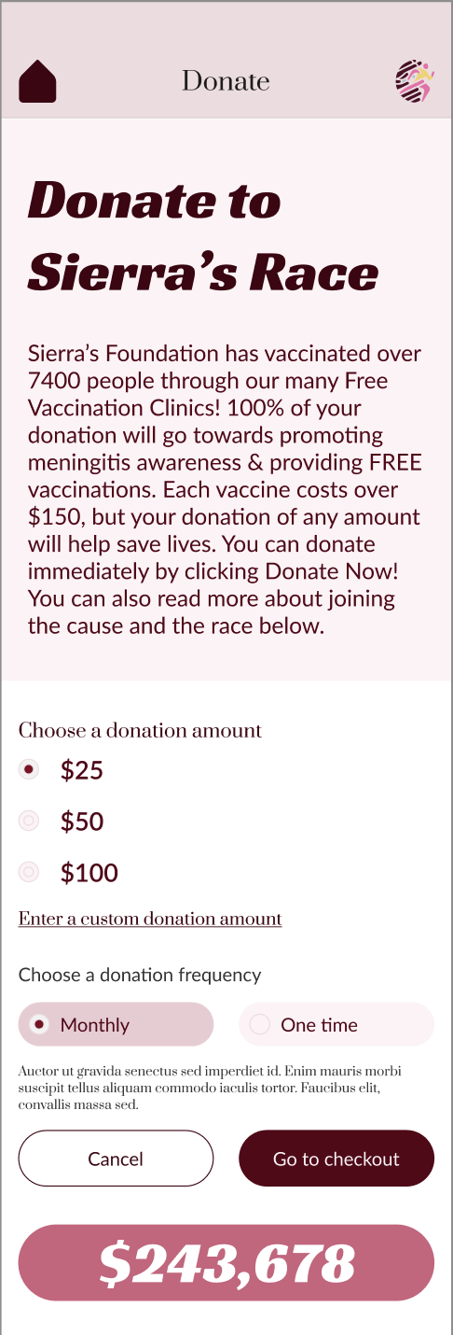
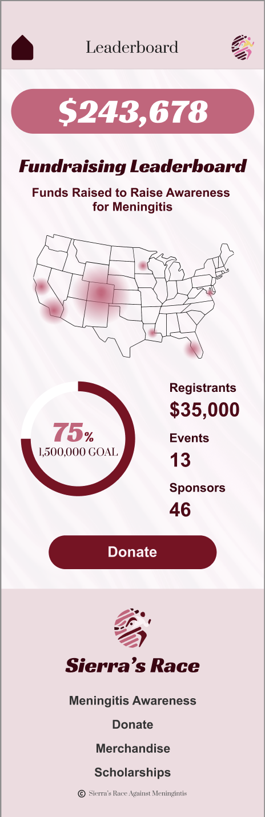
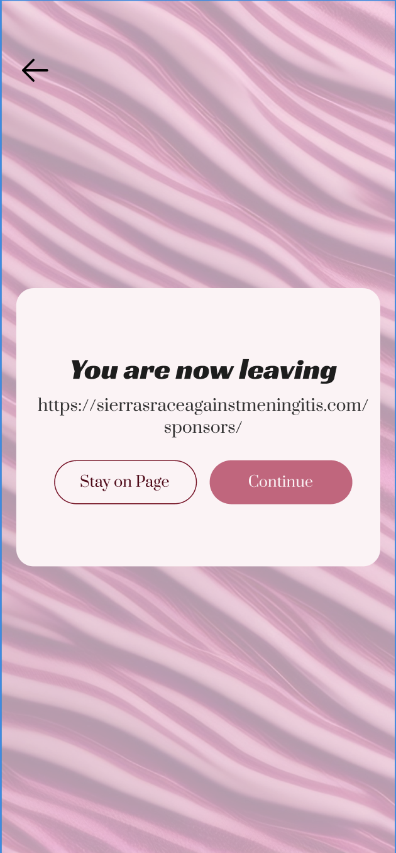
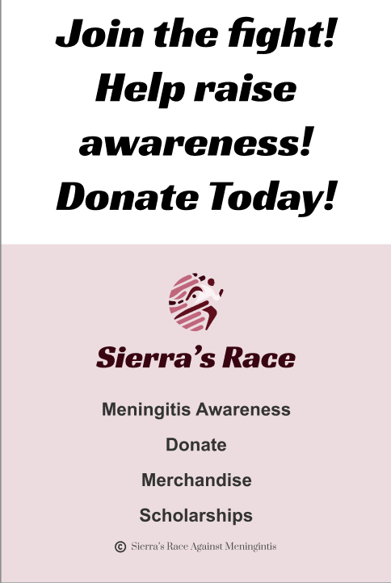
HI-FI PROTOTYPES - MOBILE 3/5
Leaving Page
Donate Page
Leader
Board
Page

Slide 20
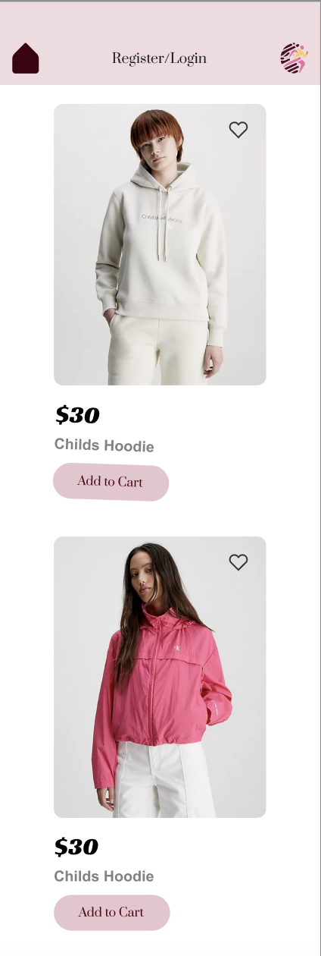
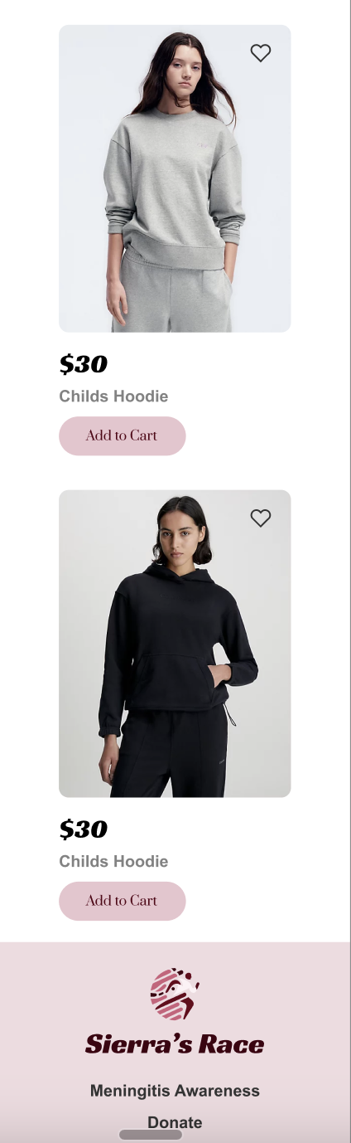
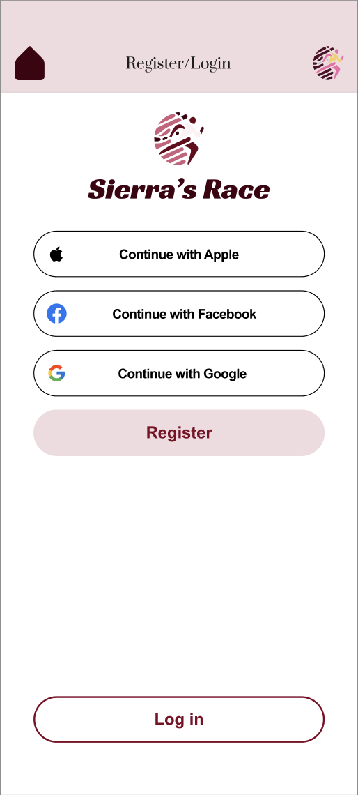
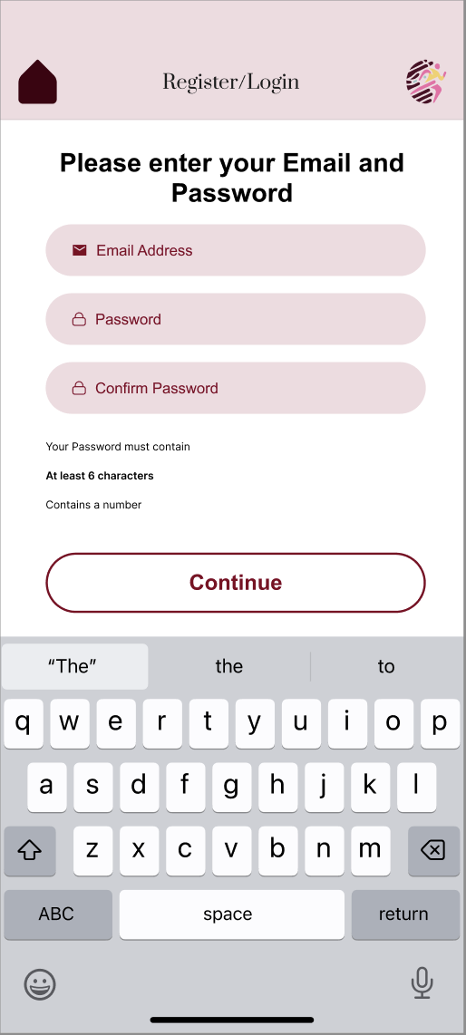
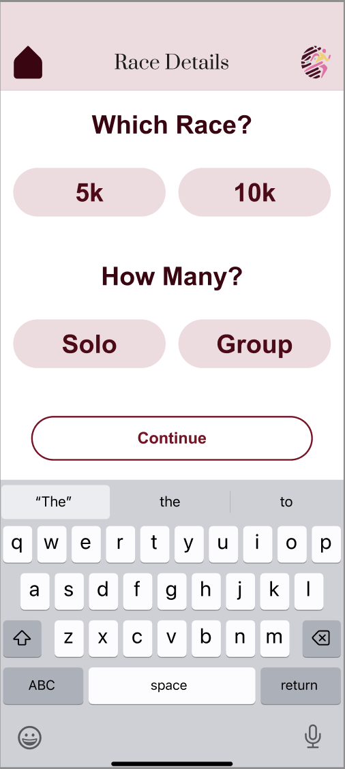
HI-FI PROTOTYPE - MOBILE 4/5
SIGN-UP PART 1
MERCH PAGE

Slide 21
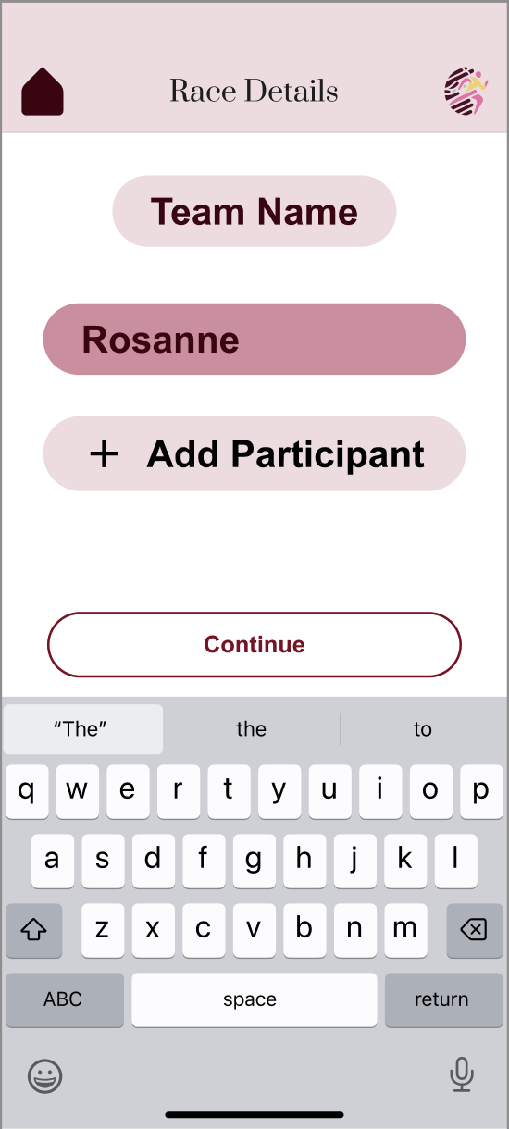

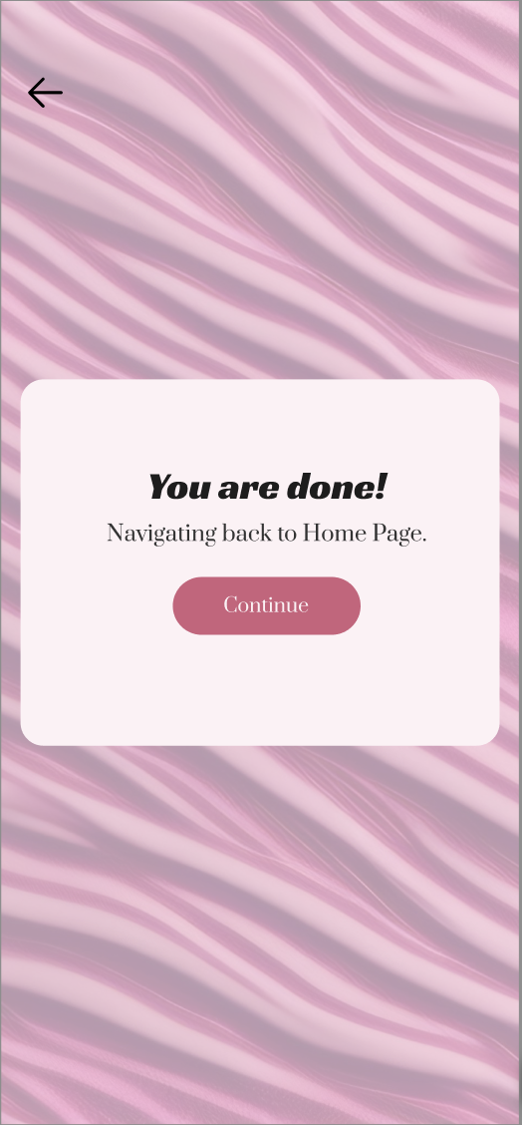
HI-FI PROTOTYPE - MOBILE 5/5
SIGN-UP PART 2

Slide 22
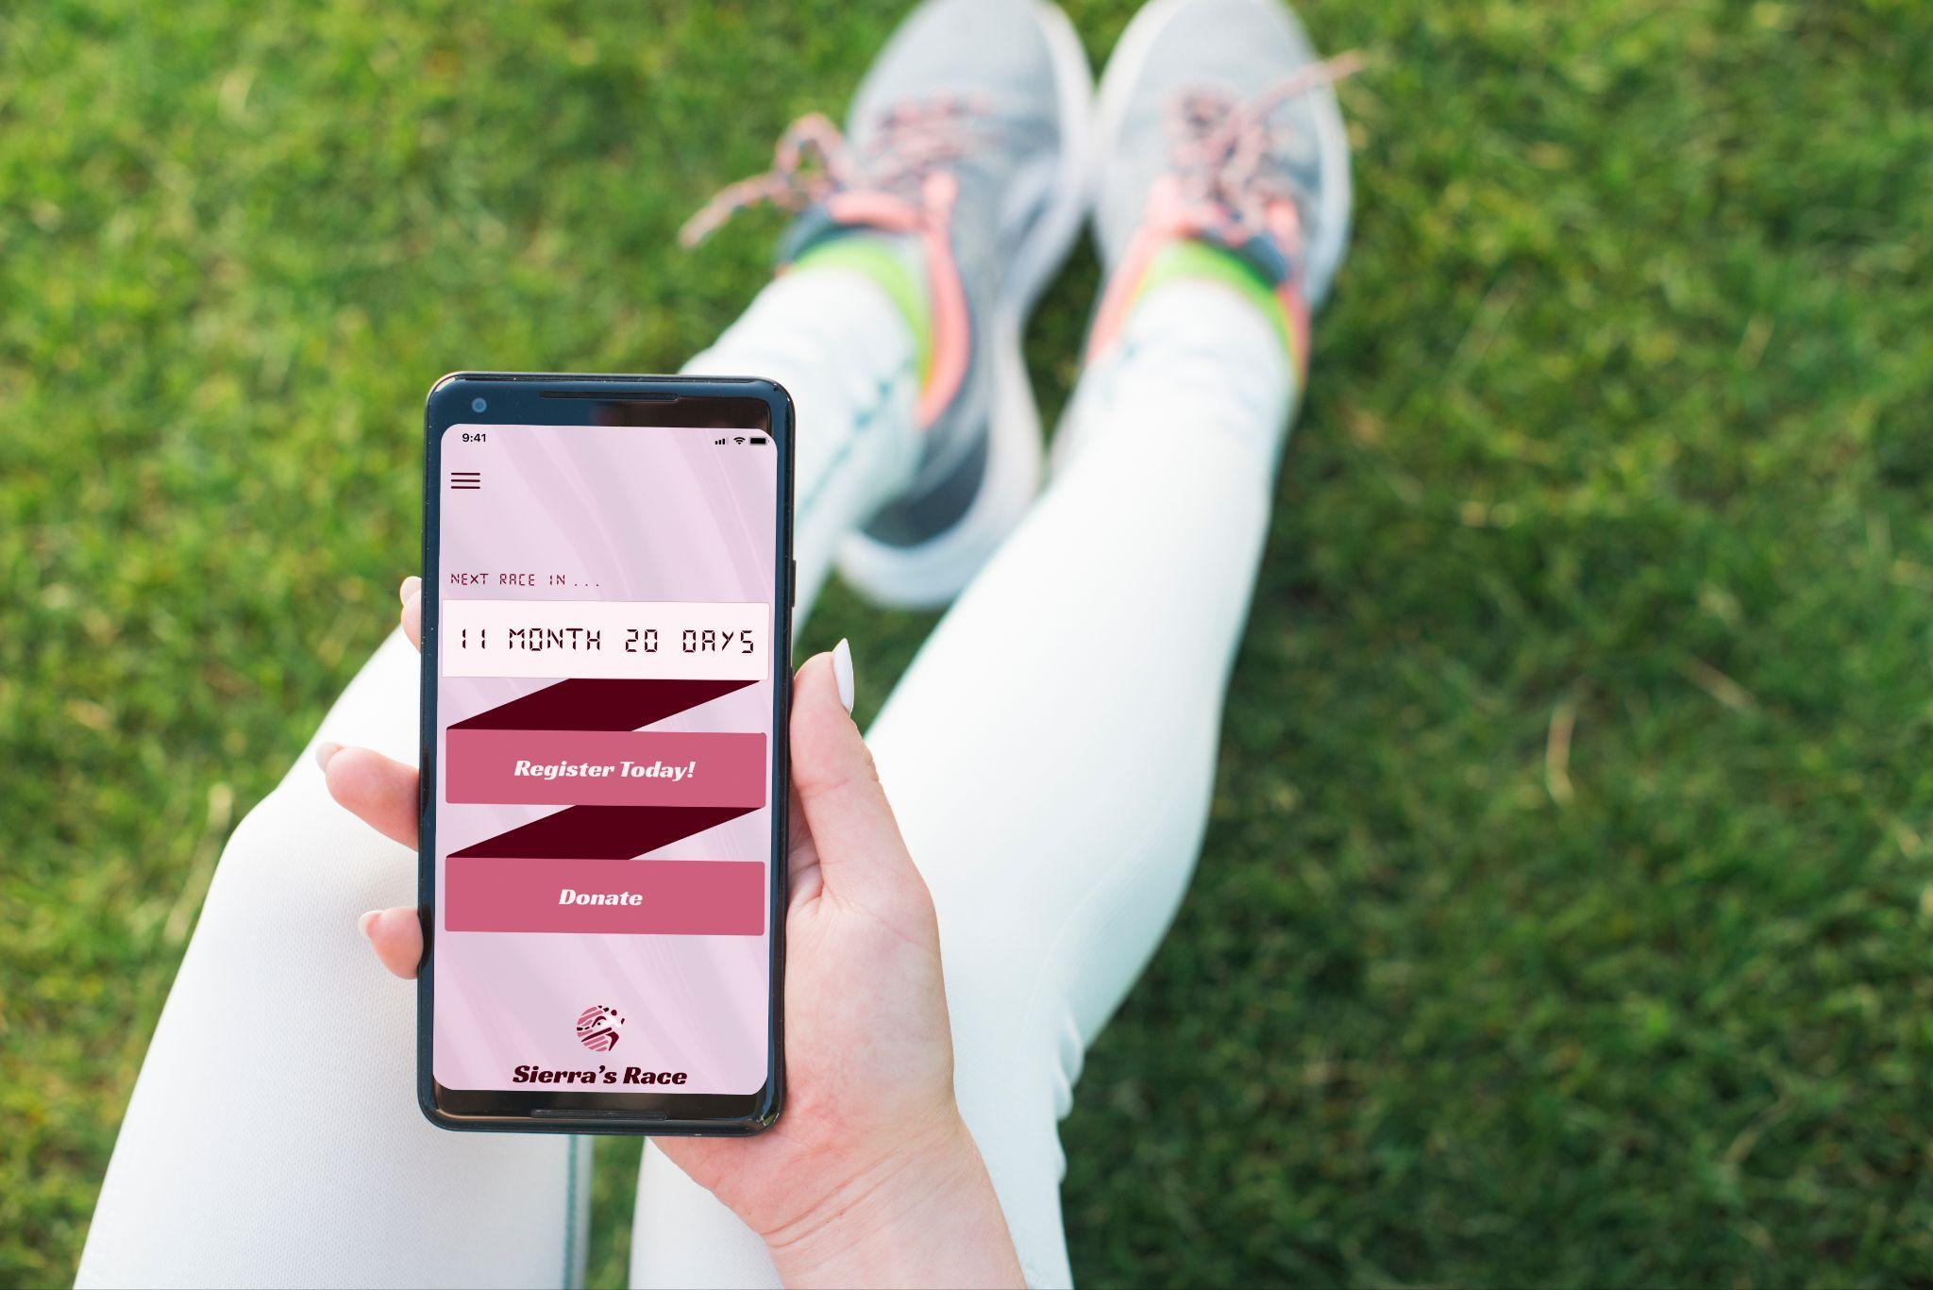
Desktop Prototype
Mobile Prototype

Slide 23
UI TESTING SLIDES

Slide 24
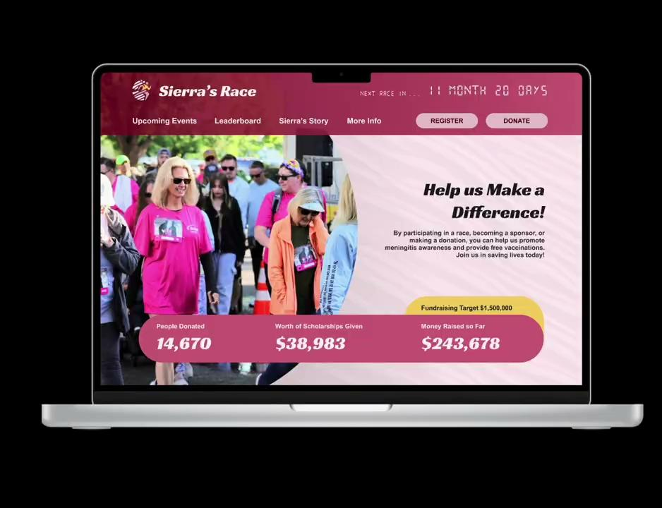
USABILITY TESTING
“The desktop layout is easy to navigate and visually appealing. I particularly love the countdown clock at the top of the page. The effective use of white space enhances the website's hierarchy and readability. The incorporation of pink seamlessly integrates with Sierra's original color scheme, making the design both user-friendly and eye-catching.”

Slide 25
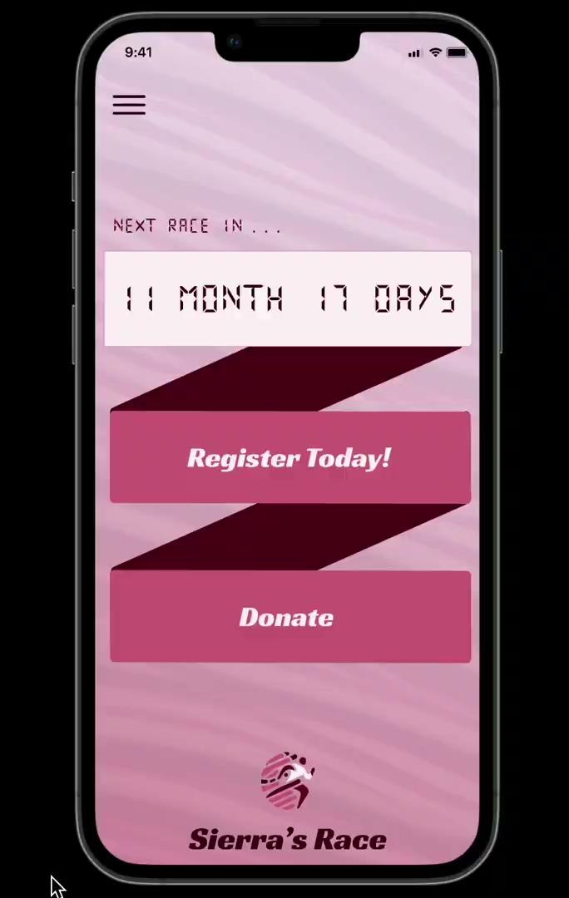
USABILITY TESTING PART 2
"The mobile version retains the same vibrant pink aesthetic as the desktop wireframes but has less white space. I appreciate the use of a carousel for images, which reduces visual clutter and improves navigation. While it closely mirrors the desktop layout, there are subtle differences that adapt it for mobile use. However, it could be made a bit more similar to the desktop version."

Slide 26
FINAL PROTOTYPE

Slide 27
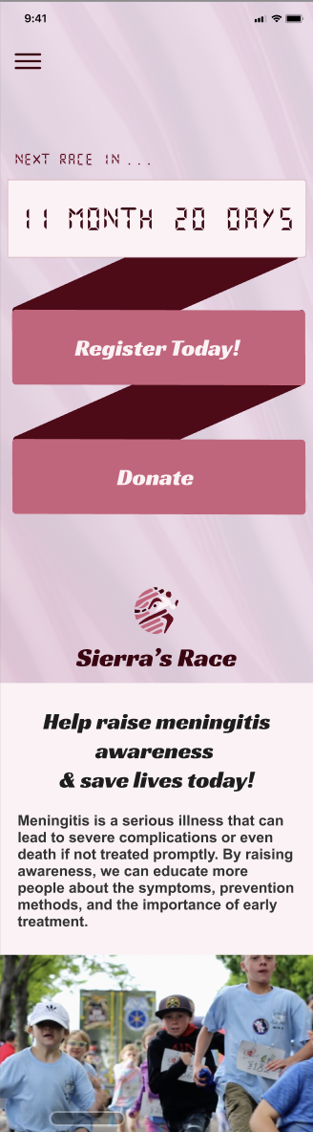
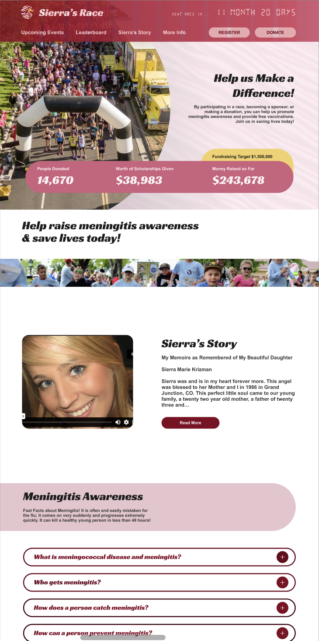
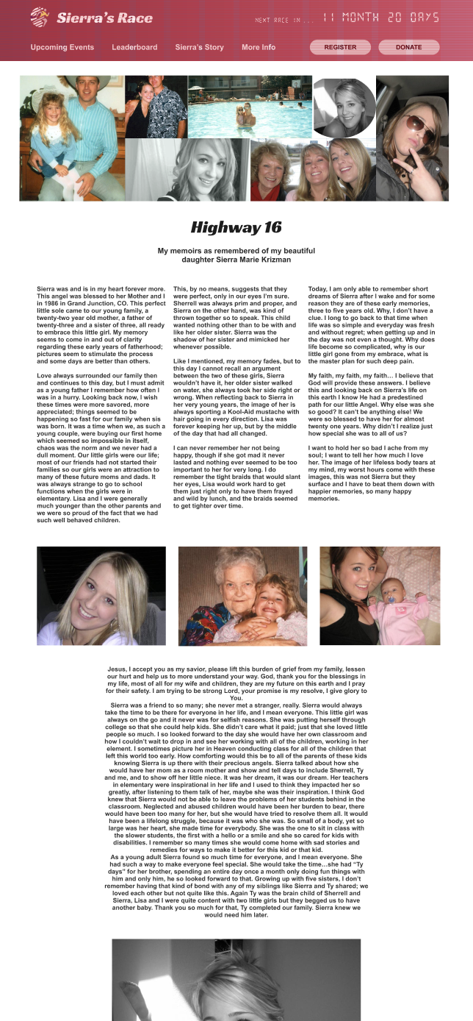

Notes:
Final style guide & Prototypes

Slide 28
IN CONCLUSION…

Slide 29
The redesign of “Sierra’s Race” website simplifies access to Meningitis information & her story, streamlines donations, and showcases the nonprofit’s offerings in a modern style. Given more time, we would further align the desktop and mobile versions for a comprehensive user experience.

Slide 30
Moving Forward
We look forward to more user testing to verify design decisions
Hearing feedback from Stakeholders
Improving the gallery & mobile version
Reach out to Sierra’s Family for their personal opinion!

Slide 31

Thank You for Your Time!

